Slide 1
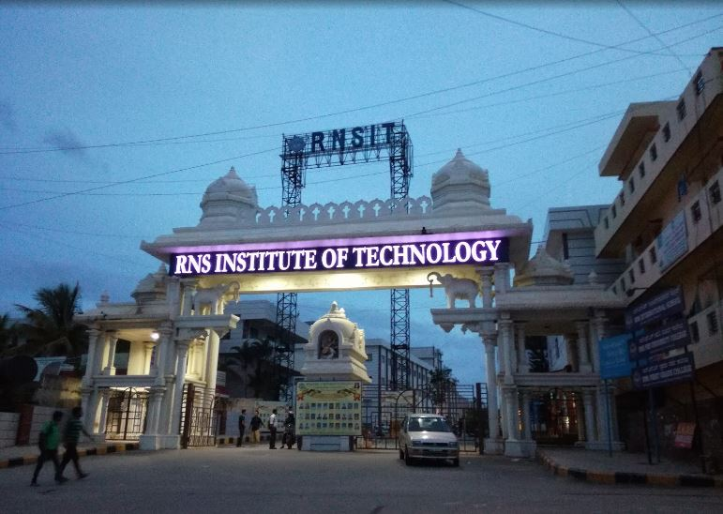
Li-Fi Based Automatic Traffic Signal Control For Ambulance
National Conference
on
Computing Technology - 2023 (NCCT'23)
PI239
By
Amardeep Kumar 1RN19IS020
Amartya 1RN19IS021
Anushka Jaiswal 1RN19IS035
Devendra Upadhyay 1RN19IS056
Under the Guidance of
Ms. Vanishri S

Slide 2
Contents
Abstract
Introduction
Literature Survey
Problem Identification
Objective
Methodology
System Design
Implementation
Conclusion
Future Enhancements
References
Q & A

Slide 3
Abstract
India is a fast-developing country, but its traffic management is ineffective, leading to road congestion in metropolitan cities like Bengaluru.
Ambulance services are severely affected by traffic jams, resulting in loss of lives as they fail to reach their destination on time.
Li-Fi, a form of bi-directional Visible Light Communication, can be used to implement an efficient and feasible traffic management system.
Li-Fi-based communication systems can provide faster communication for emergency vehicles such as ambulances, firefighting trucks, and police vehicles, especially in traffic-dense areas.

Slide 4
Introduction
BACKGROUND
Visible light communication (VLC) is an emerging platform that uses visible light frequencies between 400 and 800 THz.
Li-Fi is a VLC protocol that uses LED bulbs as the principle source of light, which can be modulated at very high speeds to transmit data.
Wireless communication relies solely on radio waves, but the spectrum is congested and expensive and an alternative is needed.
Gamma rays, X-rays, infra-red, and ultraviolet rays cannot be used for V2V communication due to their harmful effects on human body.

Slide 5
Introduction
EXISTING SYSTEM
Manual control: involves human operator who changes signal timing based on judgment of traffic flow, but is susceptible to human error leading to inefficiencies and delays.
Fixed-time control: pre-determined and fixed signal timing regardless of traffic volume, easy to implement but can cause delays and congestion during peak traffic periods.
Actuated control: Actuated control is a method that utilizes sensors to detect the presence of vehicles or pedestrians at the intersection and adjust the signal timing based on real-time traffic flow. However, this method is not specifically focused on emergency vehicles and their need for priority in traffic signal control.

Slide 6
Introduction
PROPOSED SYSTEM
LED-based LiFi transmitters will be installed in emergency vehicles, which will communicate with LiFi receivers installed in the traffic signal poles.
The system will use LiFi communication technology to transmit information about the emergency vehicle's location and direction to the traffic signal controller.
The traffic signal controller will analyze the received data and automatically adjust the signal timing to give priority to the emergency vehicle.
The proposed system is cost-effective, reliable, and efficient compared to traditional traffic signal control systems.

Slide 7
Literature Survey
Sl No | Title of the paper | Authors and year of publication | Summary | Future Enhancement
1. | A GPS based traffic light pre-emption control system for emergency vehicles | Abubakr S. Eltayeb; Halla O. Almubarak; Tahani Abdalla Attia 2013 | The design and implementation of an automatic preemption traffic control system, based on the global positioning system satellites. | Gps requires a lot of energy.
2. | Implementing Intelligent Traffic Control System for Congestion Control, Ambulance Clearance and Stolen Vehicle Detection | Rajeshwari S., Santhoshs Hebbar, Varaprasad Golla 2015 | Each individual vehicle is equipped with special radio frequency identification (RFID) tag (placed at a strategic location).They used RFID reader, NSK EDK-125-TTL, and PIC16F877A system-on-chip to read the RFID tags attached to the vehicle. | Low security offered where RFID messages are prone to unauthorized access.

Slide 8
Literature Survey
Sl No | Title of the paper | Authors and year of publication | Summary | Future Enhancement
3. | GPS and ZigBee Based Traffic Signal Preemption | Vineeth Kodire, Sreebha Bhaskaran, Vishwas H.N. 2016 | The proposed system uses GPS method to get the location data and employs ZigBee for communicating efficiently with the intersection module. | Since the technology used in Zigbee is of low bit rate, the transmission rate of this technology is also low.
4. | Advanced Automation Control in an Ambulance under Emergency Condition | Leila Sai Krishna; Samineni Vijay Chowdary; M. Pushpavalli; P. Sivagami 2017 | The ambulance is implemented with embedded system units, which finds the accident spot and delivers the spot to the close by ambulance through GSM.The ambulance guides the traffic lights in the roadway to the hospital and it also checks the next consecutive signal to shorten the time loss. | Gsm is congested and requires high bandwidth.

Slide 9
Literature Survey
Sl No | Title of the paper | Authors and year of publication | Summary | Future Enhancement
5. | Emergent vehicle tracking system using IR sensor | Manjunath Managuli; Abhaya Deshpande; Sudha H Ayatti 2017 | During object motion IR sensors detect the ambulance, pass the message to main controller which reflects the LED bulb to glow leading to closing of all the signals track, and immediately the emergent vehicle pass the signal track. | Sunlight can cause interference with IR signals.
6. | Leveraging Emergency Response System Using the Internet of Things. A Preliminary Approach | Luz A. Magre Colorado; Jorge Franco Ibañez; Juan Carlos Martinez-Santos 2020 | Hybrid system that uses both QR code detection and a GPS/GPRS tracking system. With this mixed implementation we are trying to lower the chances of getting errors when detecting the current location and improve the times of response of the emergency vehicle. | At the moment, a simple test over an intersection of the city is ongoing, but not finished. For future experiments, we expect to include more extensive areas and integrate MATLAB to the simulation to measure times.

Slide 10
Literature Survey
Sl No | Title of the paper | Authors and year of publication | Summary
7. | Efficiency of opportunistic cellular/LiFi traffic offloading | Vishnu Raj RS,Athi Narayanan S,Kamal Bijlani 2016 | This offloading efficiency is a measure of the ratio of traffic carried by light fidelity (LiFi) network to total traffic carried by both LiFi and cellular networks. The effect of LiFi-signal blocking and channel characteristics are considered. Different LiFi offloading timing cases are discussed.
8. | Li-Fi technology in traffic light | V.K.G. Kalaiselvi; A. Sangavi; Dhivya 2017 | The proposed paper aims in using the Li-Fi technology and enabling communication of vehicles with the traffic light system in order to prioritize the vehicles and change the signals accordingly rather than by a process of pre-defined order or by manual order.

Slide 11
Literature Survey
Sl No | Title of the paper | Authors and year of publication | Summary
9. | Li-Fi Based Smart Traffic Network | A. Correa; A. Hamid; E. Sparks 2018 | Using Li-Fi, a visible light communications system, autonomous cars will be able to communicate with each other and with the traffic network to eradicate any human error that might occur while driving today.
10. | Li-Fi Based Automatic Traffic Signal Control for Emergency Vehicles | R Shanmughasundaram; S Prasanna Vadanan; Vivek Dharmarajan 2018 | In this paper, a V2V communication system is proposed in which the headlight and tail light of a vehicle are made as Li-Fi transmitter and Li-Fi receiver respectively. Using the proposed system, when a traffic signal receives an alert regarding an emergency vehicle, the traffic signal would immediately turn green. Thus, decreasing the waiting time of emergency vehicles in traffic dense lanes.

Slide 12
Problem Identification
Cities with continually growing populations but the same infrastructure cause more traffic through the same points, making it difficult to follow the recommended 8-10 minute response time for medical emergencies like cardiac arrest or stroke.
The current systems are based on fixed timers or sensors and do not take into account the priority of emergency vehicles.
The existing traffic signal control systems are not designed to prioritize emergency vehicles like ambulances, firefighting, and police vehicles, resulting in delayed response times, which can have catastrophic consequences, especially in cases of medical emergencies.

Slide 13
Objectives
Reduce response time of emergency vehicles.
Improve overall traffic flow in the city while providing priority passage.
Minimize risks of accidents and loss of lives due to delayed response times of emergency vehicles.
Provide immediate response from hospital side for emergency vehicle and connect all hospitals to one platform using IoT.
Increase adoption of LiFi technology for communication and traffic management in smart cities.

Slide 14
Methodology
Li-Fi protocol represents data by varying the intensity of LED light.
High intensity represents a binary 1, while low intensity represents a binary 0.
Any LED fixture with a signal processing circuit can work as a Li-Fi transmitter, while a photodiode with a demodulation circuit can work as a receiver.
Li-Fi achieves high-speed data transmission, up to several gigabits per second.
The working of Li-Fi involves modulating a light source, typically an LED, to encode data in light pulses.
The photodetector receives the light pulses and converts them back into electrical signals.
The receiver then detects changes in light intensity and decodes the data from the light signals.

Slide 15
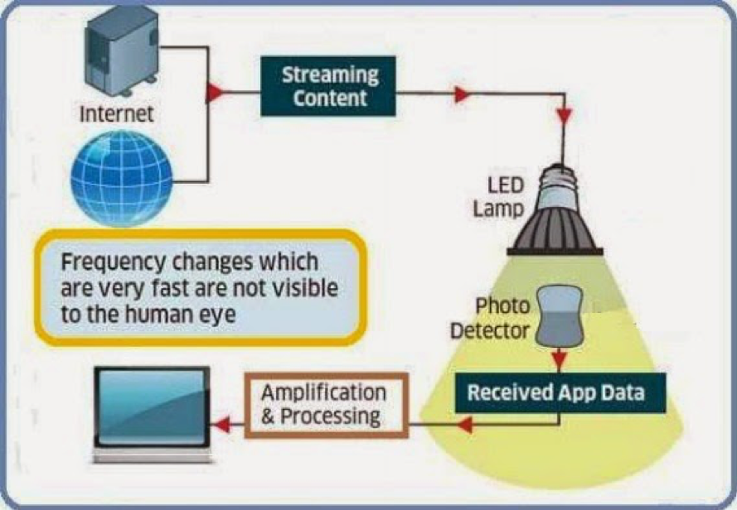
Methodology

Slide 16
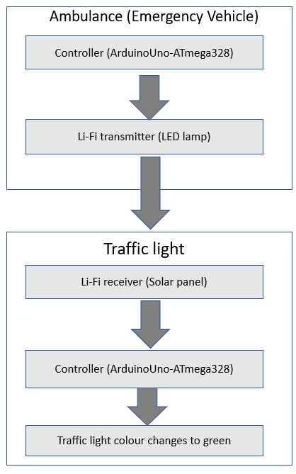
System Design
Two main nodes: the ambulance (emergency vehicle) and the traffic signal control.
The nodes are powered by microcontrollers, which control the transmission and reception of data.
The ambulance node includes a Li-Fi transmitter.
The traffic signal node is equipped with a Li-Fi receiver.
The microcontroller located within the traffic signal node decrypts the received signal and triggers the traffic signal LED light to change the color of a particular direction to green.

Slide 17
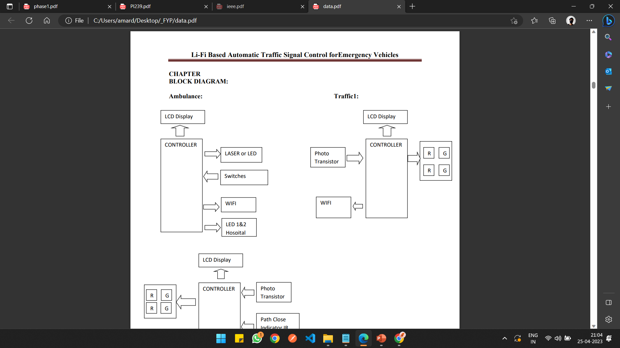
System Design
Block diagram of ambulance module
Block diagram of traffic light1 module

Slide 18
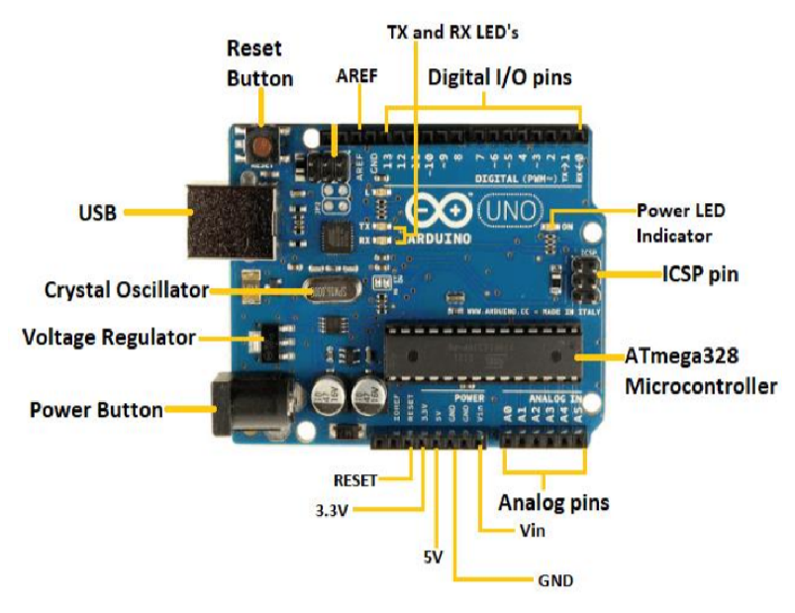
Implementation
COMPONENTS:
Controller-Arduino Uno ATmega328:
14 digital input/output pins (with 6 that can function as PWM outputs)
6 analog inputs
The board can run on an external power supply of 6 to 20 volts.
If less than 7V is supplied, the 5V pin may output less than 5 volts and the board may be unstable.
Outputs a regulated 5V from the onboard regulator.

Slide 19
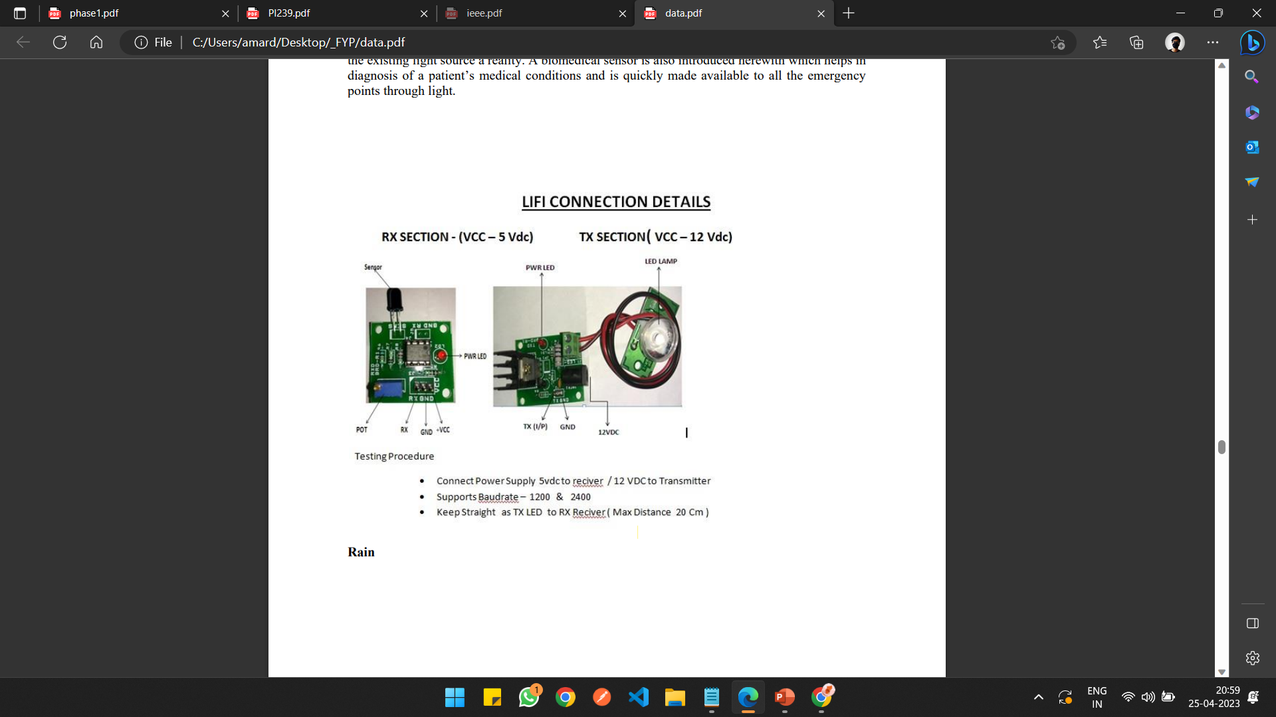
Implementation
COMPONENTS:
Li-Fi transmitter - LED lamp:
LED lamps are an affordable and low-power option for Li-Fi transmission, making them ideal for traffic signal control systems.
A baud rate of 1200 is recommended for optimal performance.
At this baud rate, LED lamps can transmit data faster.
They can be easily installed in existing traffic lights, simplifying the setup process.

Slide 20
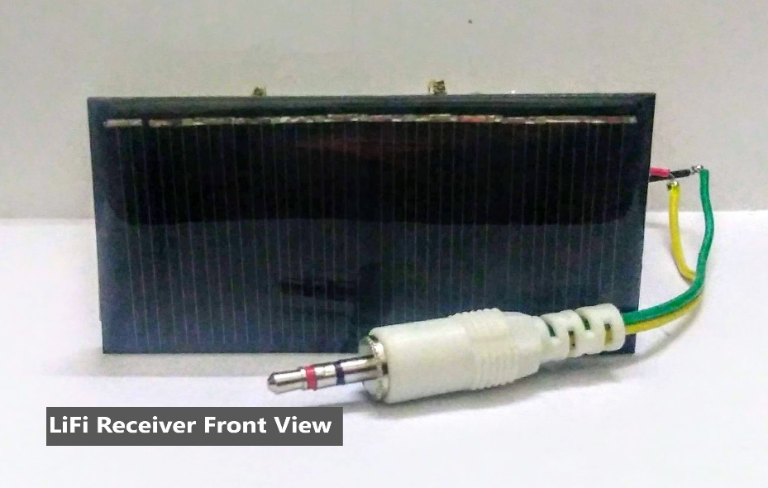
Implementation
COMPONENTS:
Li-Fi receiver - Solar Panel:
The use of a solar panel ensures a self-sufficient and sustainable power source for the traffic signal control node.
The system is energy efficient and cost-effective for reliable data transmission.

Slide 21
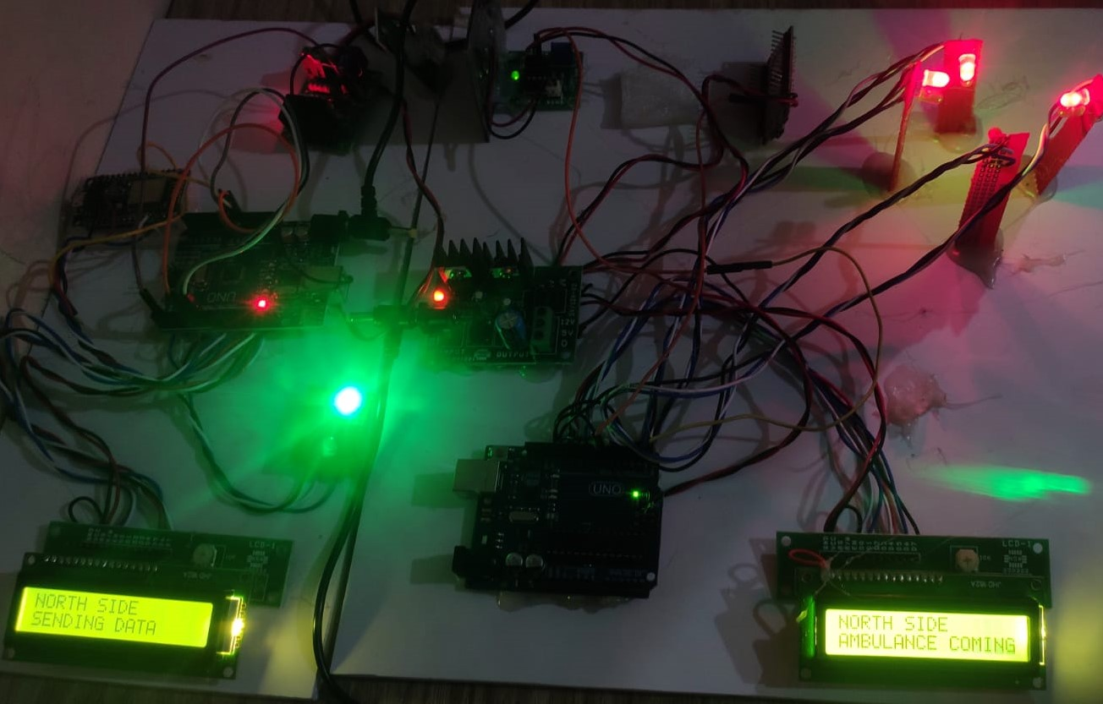
Implementation
Figure showing ambulance sending north direction signal and traffic light receiving it.

Slide 22
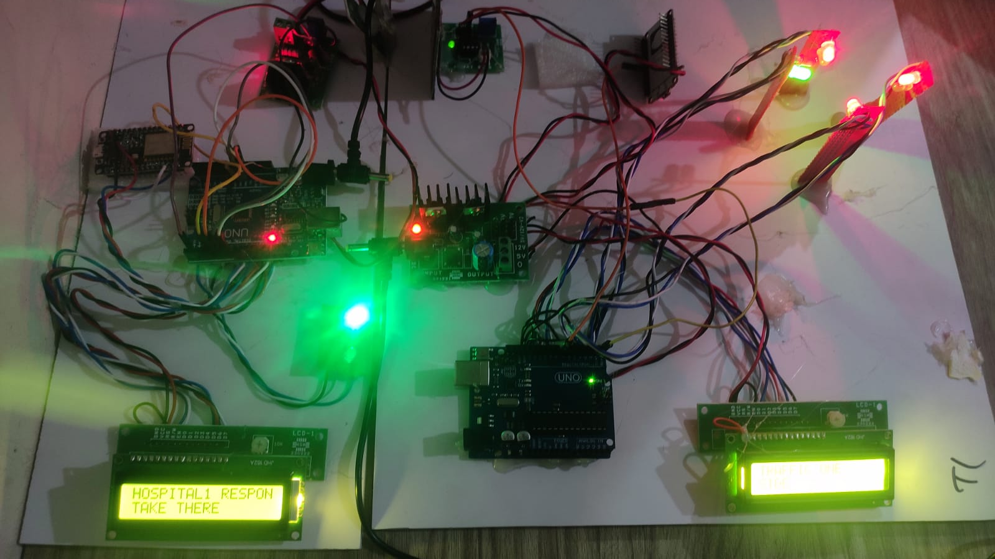
Implementation
Figure showing ambulance receiving hospital1 response.

Slide 23
Conclusion
The experimental implementation of the LiFi based traffic signal control system for ambulance has demonstrated significant improvements in emergency response times compared to the existing system.
The cost-effectiveness of Li-Fi technology makes it an efficient and environmentally friendly alternative to existing cellular-based traffic management systems.
Using the Li-Fi communication infrastructure various other data can also be sent from one vehicle to another.
If this system is implemented in the real world, many lives can be saved as the emergency vehicles would wait for very less time in traffic jams.

Slide 24
Future Enhancement
ML implementation for traffic signal optimization based on emergency data analysis
LiFi system expansion to other emergency vehicles like fire trucks and police cars
Improving LiFi's accuracy and reliability for better effectiveness
Enhancing V2V communication capabilities by incorporating additional sensors and protocols for real-time data exchange, allowing for more informed traffic signal decisions.

Slide 25
References
[1] H. Noori, “Modeling the Impact of VANET-Enabled Traffic Lights Control on the Response Time of Emergency Vehicles in Realistic LargeScale Urban Area,” 2013.
[2] A. S. Eltayeb, H. O. Almubarak, and T. A. Attia, “A GPS Based Traffic Light Pre-emption Control System for Emergency Vehicles,” 2013.
[3] R. S. Rajeshwari, S. Hebbar, and V. Golla, “Implementing Intelligent Traffic Control System for Congestion Control, Ambulance Clearance and Stolen Vehicle Detection,” 2015.
[4] V. Kodire, S. Bhaskaran, and V. H.N., “GPS and ZigBee Based Traffic Signal Preemption,” 2016.
[5] L. Sai Krishna, S. Vijay Chowdary, M. Pushpavalli, and P. Sivagami, “Advanced Automation Control in an Ambulance under Emergency Condition,” 2017.
[6] M. Managuli, A. Deshpande, and S. H. Ayatti, “Emergent vehicle tracking system using IR sensor,” 2017.
[7] P. Devi and S. Anila, “Intelligent Ambulance with Automatic Traffic Control,” 2020.
[8] L. A. Magre Colorado, J. Franco Ibanez, and J. C. Martinez-Santos, “Leveraging Emergency Response System Using the Internet of Things,” 2020.

Slide 26
References
[9] V.K.G. Kalaiselvi, A. Sangavi, and Dhivya, “Li-Fi technology in traffic light,” 2017
[10] V. Raj, A. Narayanan, and K. Bijlani, “Efficiency of opportunistic cellular,LiFi traffic offloading,” in 2017 2nd IEEE International Conference on Recent Trends in Electronics, Information and Communication Technology (RTEICT), 2017.
[11] A. Correa, A. Hamid, and E. Sparks, “Li-Fi Based Smart Traffic Network,” in 2018 IEEE 88th Vehicular Technology Conference (VTCFall).
[12] R. Shanmughasundaram, S. Prasanna Vadanan, and V. Dharmarajan, “LiFi Based Automatic Traffic Signal Control for Emergency Vehicles,” in 2018 IEEE Global Conference on Wireless Computing and Networking (GCWCN), 2018.
[13] A. Patni, B. Mishra, H. Aditya, Y. Kumar, and R. Sharma, “Highway Navigation Using Light Fidelity Technology,” in 2015 IEEE 12th International Conference on Mobile Ad Hoc and Sensor Systems (MASS), 2015.
[14] J. Saradha, G. Vijayshri, and T. Subha, “Intelligent traffic signal control system for ambulance using RFID and cloud,” in 2017 International Conference on Innovations in Information, Embedded and Communication Systems (ICIIECS), 2017.
[15] J. I. Janjua, T. A. Khan, M. S. Khan, and M. Nadeem, “Li-Fi Communications in Smart Cities for Truly Connected Vehicles,” in 2021 International Conference on Information Networking (ICOIN), 2021

Slide 27

Thank you

